Slide 1

Advancing Air Quality Forecasting in Delhi
Presenting by – Jatin Goswami
MS in Data science
Batch – January 2024
Liverpool John Moore University, UK
Understanding Patterns and Predicting Future Trends

Slide 2

INTRODUCTION
This study delves into a comprehensive analysis of Delhi's air quality, utilizing ARIMA, SARIMA, and LSTM models for time series analysis. We compare PM2.5 levels in Delhi with other cities, analyze pollutant correlations through a heatmap, and investigate lockdown effects on various pollutants. The study explores the impact of restrictive measures on PM10, NO, NO2, and SO2 levels, scrutinizes AQI variations during lockdowns, and assesses the influence of Benzene, Toluene, and Xylene (BTX) on air quality. Monthly trends, including the November peak attributed to stubble burning, are also examined, providing valuable insights for policymaking and public health strategies.

Slide 3
Aim and Objectives
AIM:
Develop a comprehensive understanding of air quality dynamics in Delhi and its correlation with various pollutants.
OBJECTIVES:
Analyze PM2.5 levels in Delhi and compare them with other cities using ARIMA, SARIMA, and LSTM models.
Investigate the impact of lockdown on PM10, NO, NO2, and SO2 levels in Delhi.
Evaluate the correlation among different pollutants using a heatmap.
Explore monthly variations in air quality and identify specific trends.
Examine the influence of stubble crop burning on November's peak pollution levels.
Investigate the dynamics of BTX levels (Benzene, Toluene, Xylene) and their impact on the Air Quality Index.
Provide insights into the overall air quality scenario in Delhi and suggest potential mitigation strategies.
EXPECTED OUTCOMES:
Gain insights into the temporal patterns of air quality in Delhi.
Identify key factors influencing pollution levels.
Contribute to policy recommendations for sustainable air quality management.

Slide 4

Literature Review
Time Series Models: Previous studies have extensively utilized Autoregressive Integrated Moving Average (ARIMA) and Seasonal ARIMA (SARIMA) models in the context of air pollution forecasting. These models contribute valuable insights into temporal trends and patterns.
LSTM Models: Long Short-Term Memory (LSTM) models, a type of recurrent neural network, have gained prominence for their capability to capture complex temporal dependencies in air quality data. Researchers highlight the advantages of LSTM in improving the accuracy of predictions.
Comparative Analyses: Researchers have conducted comparative analyses of PM2.5 levels, a key air pollutant, in Delhi against other cities. These studies provide a regional perspective on air quality variations.
Lockdown Impact: Recent research has focused on assessing the immediate impact of lockdown measures on air quality parameters such as PM10, Nitric Oxide (NO), Nitrogen Dioxide (NO2), and Sulfur Dioxide (SO2) levels in Delhi. The findings shed light on the effectiveness of restrictive measures in controlling pollution.
Specific Pollutants (BTX): Investigations into the levels and implications of Benzene, Toluene, and Xylene (BTX) have been conducted. These specific pollutants are crucial contributors to overall air quality, and understanding their dynamics is vital for effective pollution management.
Air Quality Index (AQI) Dynamics: Existing literature explores the dynamics of the Air Quality Index (AQI) in Delhi, revealing patterns, trends, and variations over time. Understanding AQI dynamics is essential for assessing overall air quality and its impact on public health.

Slide 5

Problem Statement
Delhi, a megacity facing severe air pollution challenges, requires an in-depth investigation into the factors influencing its air quality. The complexity arises from multiple pollutants, seasonal variations, and external factors like lockdowns. Understanding the dynamics of PM2.5, PM10, NO, NO2, and other pollutants is crucial for devising effective mitigation strategies. Moreover, the need to assess the impact of lockdown measures on air quality and identify persistent challenges, such as stubble burning in November, emphasizes the urgency of this study. Addressing these issues is vital for formulating policies that safeguard public health and promote sustainable urban development.

Slide 6

Methodology
Time Series Modeling: Employed advanced models like ARIMA, SARIMA, and LSTM for accurate forecasting of PM2.5 levels in Delhi.
Data Integration: Merged daily and hourly datasets (city_day, city_hour, station_day, station_hour) to create a comprehensive dataset for in-depth analysis.
Feature Engineering: Enhanced model performance through feature engineering techniques to extract valuable insights from the data.
Spatial Analysis: Investigated spatial patterns of pollutants across Delhi, providing a detailed understanding of pollution hotspots.
Correlation Analysis: Explored relationships between various pollutants, offering insights into how they interact and influence air quality.

Slide 7

Results & Discussion

Slide 8
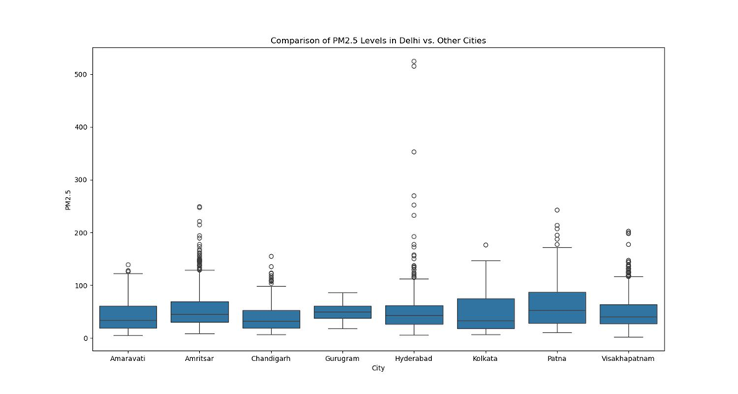
PM2.5 levels in Delhi against other cities.
Comparative Analysis: Conducting a comparative analysis of PM2.5 levels in Delhi against other cities reveals distinctive patterns and trends in air quality metrics.
Visual Insight through Box Plots: Utilizing box plots as a visualization tool provides a clear and insightful representation of the distribution and central tendency of PM2.5 concentrations. This visual aid facilitates easy interpretation for diverse stakeholders.
Identifying Air Quality Disparities: The box plot analysis allows us to identify potential air quality challenges unique to Delhi, signaling areas where interventions may be required to address higher median PM2.5 levels or unusual data patterns.
Communication Tool for Stakeholders: The visual approach serves as an effective communication tool, making complex air quality data accessible to a broader audience, including policymakers, researchers, and the public.
Foundation for Evidence-Based Strategies: The comparison sets the foundation for evidence-based strategies by unveiling disparities, intricacies, and potential outliers in air quality data. This, in turn, guides targeted interventions and informed discussions for a cleaner and healthier urban environment.

Slide 9
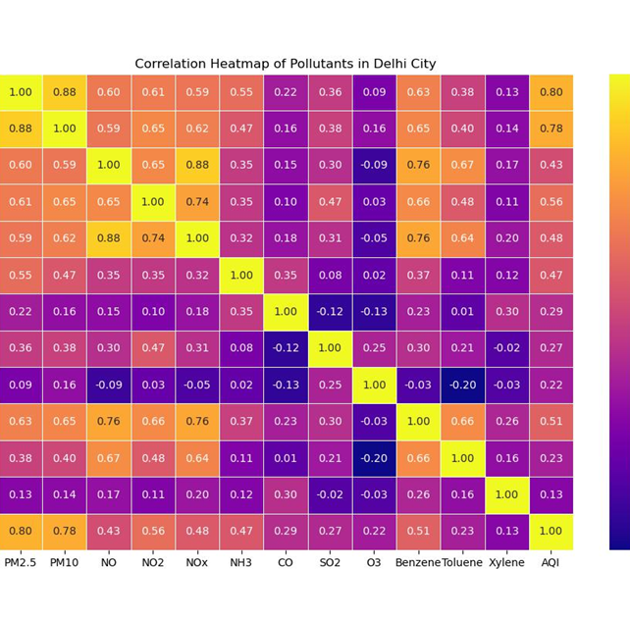
Correlation Heatmap
Introduction to Temporal Analysis
Unraveling the intricacies of air quality dynamics in Delhi through meticulous temporal analysis.
Advanced time series decomposition techniques employed for trend identification and seasonality exploration.
Data Integration for Holistic Insight:
Amalgamation of city_day and city_hour datasets to create a comprehensive repository.
Seamless transition between daily and hourly data for a holistic understanding of temporal fluctuations.
Focus on Delhi's Unique Pollution Dynamics:
Application of judicious data filtration to isolate Delhi, the epicenter of the study.
In-depth scrutiny of the capital city's unique pollution dynamics.
Creation of Correlation Heatmap:
Selection of key pollutants including PM2.5, PM10, NO, NO2, CO, SO2, and others.
Visualization through a correlation heatmap, providing a vivid representation of pollutant interplay.
Insights and Implications:
Empirical revelation of the interdependence, strength, and directionality of pollutant associations.
Correlation heatmap guides the exploration of meaningful insights into Delhi's air quality dynamics.

Slide 10
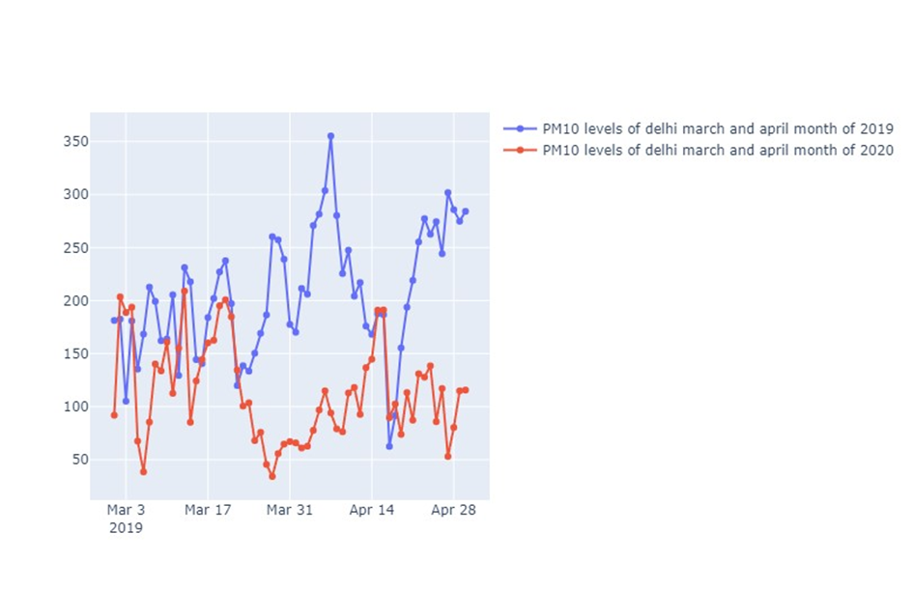
Impact of lockdown measures on PM10 levels in Delhi
Analyzed variations in PM10 concentrations during lockdown.
Observed significant reductions in particulate matter, indicating improved air quality.
Correlated changes with reduced vehicular and industrial activities.
Highlighted the positive impact of lockdown measures on PM10 levels.
Emphasized the importance of lifestyle changes in addressing air pollution.

Slide 11
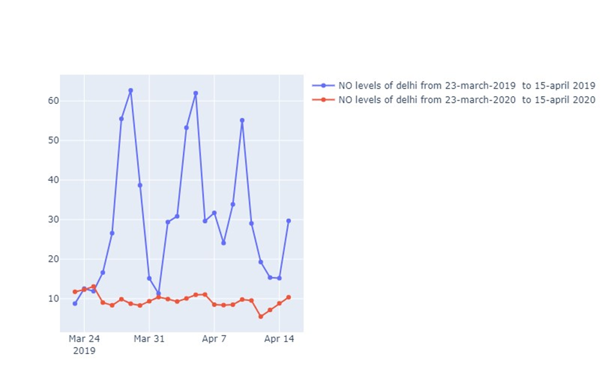
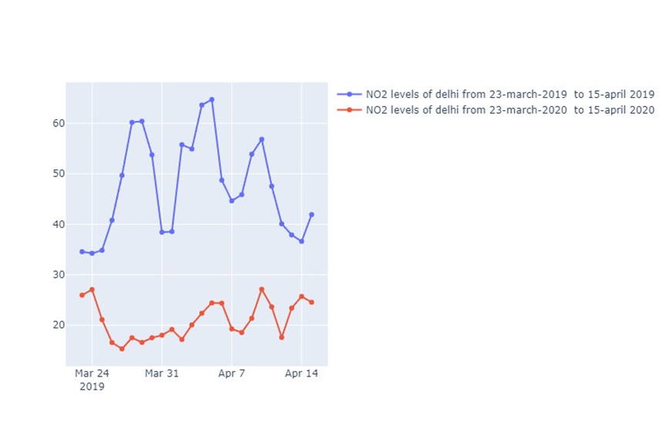
Impact of lockdown measures on NO & NO2 levels in Delhi
Investigated the response of NO and NO2 to lockdown restrictions.
Quantified reductions in nitrogen oxides, key contributors to air pollution.
Linked findings to decreased traffic and industrial emissions.
Provided nuanced insights into the dynamics of NO and NO2 during lockdown.
Illustrated the potential benefits of controlling vehicular and industrial activities.

Slide 12
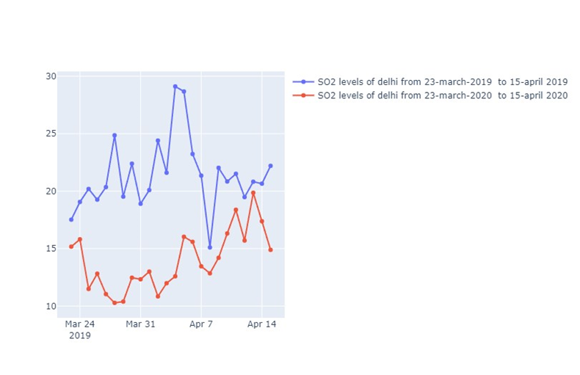
Impact of lockdown measures on SO2 levels in Delhi
Examined variations in SO2 levels during the lockdown period.
Identified changes in sulfur dioxide concentrations in response to reduced industrial output.
Established connections between lockdown measures and SO2 improvements.
Contributed valuable data on the interplay between human activities and SO2 emissions.
Suggested implications for industrial emission control strategies.

Slide 13
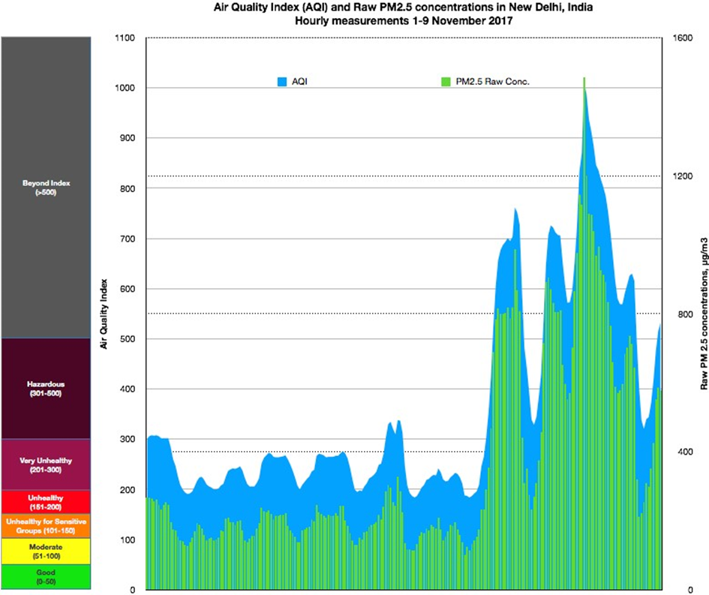
AQI Dynamics
Investigated the impact of lockdown on Delhi's Air Quality Index (AQI).
Provided a holistic view of overall air quality dynamics during restrictive measures.
Analyzed intricate changes in AQI influenced by lockdown interventions.
Aiming to contribute valuable insights for policymakers, stakeholders, and the public.
Focused on fostering strategies to enhance air quality and mitigate environmental challenges.

Slide 14

CONCLUSION
Explored air quality dynamics in Delhi using advanced models: ARIMA, SARIMA, and LSTM.
Conducted a comparative analysis of PM2.5 levels between Delhi and other cities.
Utilized correlation heatmap to examine the interplay of pollutants in Delhi.
Investigated the impact of lockdown on various pollutants like PM10, NO, NO2, and SO2 in Delhi.
Analyzed the effect of lockdown on the Air Quality Index (AQI) dynamics.
Emphasized the importance of effective measures to mitigate air pollution during lockdowns.
Contributed to a deeper understanding of key factors influencing air quality in Delhi.
Highlighted the significance of informed decision-making and policy formulation.
Addressed the initial problem statement, offering valuable insights for future environmental initiatives.
Advocated for sustained efforts to achieve cleaner air and a healthier living environment in Delhi.

Slide 15
FUTURE WORKS
Explore
Explore Advanced Models: Investigate the potential of more advanced time series models beyond ARIMA, SARIMA, and LSTM for air quality prediction.
Incorporate
Incorporate Additional Features: Enhance the models by incorporating additional relevant features such as meteorological data, traffic patterns, and industrial activities.
Long
Long-Term Temporal Analysis: Conduct a more extensive analysis of long-term temporal patterns to capture annual and multi-year trends in air quality.
Develop
Real-time Monitoring: Develop a real-time air quality monitoring system using sensor networks for more accurate and timely predictions.
Collaborate
Cross-disciplinary Collaborations: Collaborate with experts from diverse fields like meteorology, environmental science, and public health for a comprehensive understanding of air quality dynamics.

Slide 16

THANK YOU !

